Slide 1
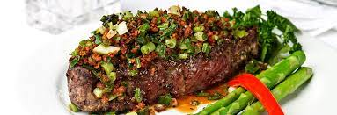
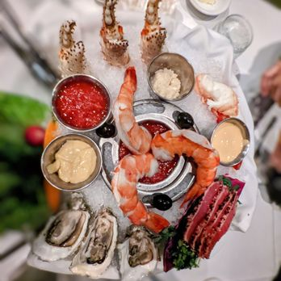
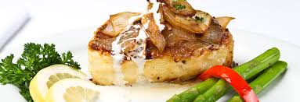

Pricing Optimization
Landon Smith & Anamika Medhi
Dr. Stephan Sorger, Marketing Analytics, Saint Mary’s College of California MSBA

Slide 2
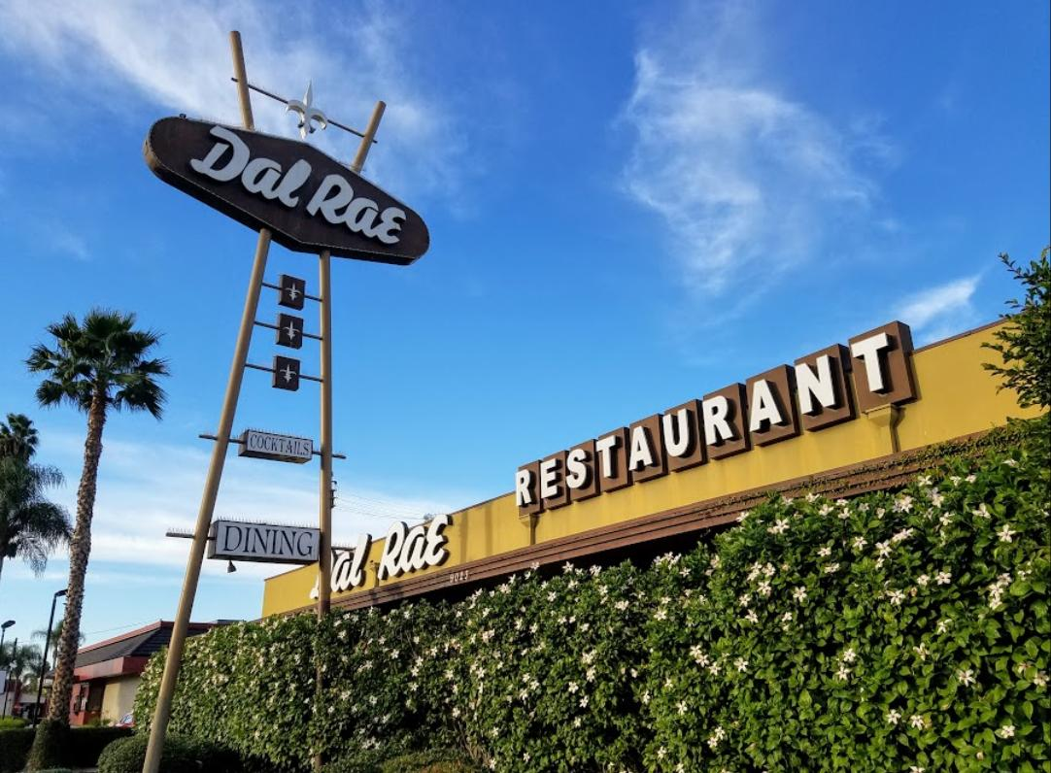
Agenda
Background & Current Situation
Metric of Interest
Problem Statement
Research Method & Analysis
Customer Sentiment-Based Solution
Model Selection
Model Results & Visualization
Results Interpretation & Conclusions
Situational Comparison
Recommendations

Slide 3
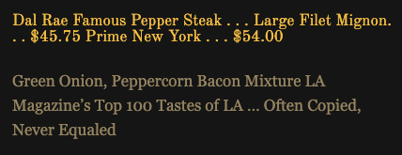
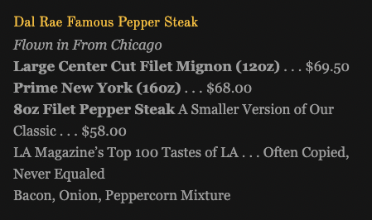
Situation: Burning Platform
2019
“The original Dal Rae was opened in 1951, moved to its current location in Pico Rivera, CA in 1958, and is now long known as an LA institution. It has built a reputation of excellence and a loyal customer base that has been dining there for generations.” - Dal Rae Website
Due to rampant inflation post-covid pandemic, the cost of red meat based inventory for steakhouses has increased dramatically in a condensed amount of time
To cope with higher cost of inventory, the Dal Rae has been forced to make tradeoffs that customers may view as detrimental to their business in order to maintain the same level of profitability post-covid
Reduction in portion sizes
Increase in menu price
Reduction of staff
2023

Slide 4
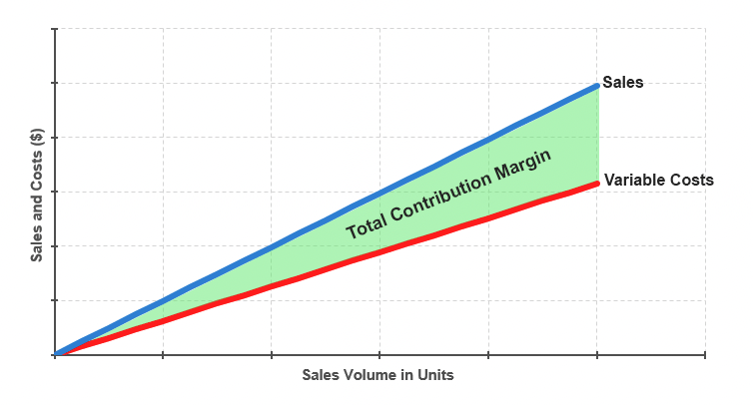
Dal Rae Contribution Margin Post-Covid: Red Meat Menu Items
In order to simplify the task of evaluating the Dal Rae’s profitability on red meat based inventory, we take two initial steps:
We use an intermediary metric to measure Dal Rae’s profitability called contribution margin
Contribution margin represents the portion of a product’s sales revenue that isn't used up by variable costs
Because the increased inventory costs the Dal Rae is experiencing are variable costs, this metric is more accurate for the purposes of this project
We use the three most popular red meat menu items within set price tiers to approximate Dal Rae contribution margin
The POS system the Dal Rae uses to track its sales is limited in its functionality, forcing the manual collection and computation of data in certain areas
Due to the tedious nature of acquiring all data, the most popular menu items will be used as proxies to approximate the contribution margin of items within various price ranges

Slide 5
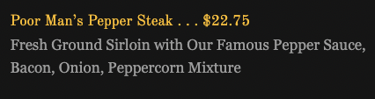
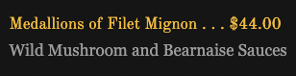
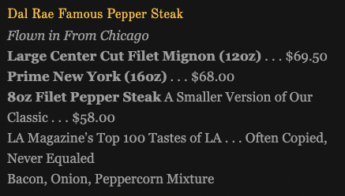
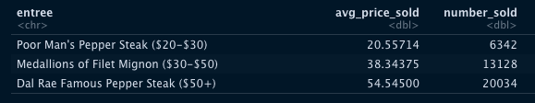
Dal Rae Contribution Margin Post-Covid: Red Meat Menu Items
In order to determine proxy contribution margin before and after the Covid-19 pandemic, we accessed POS sales data ranging from January 1st, 2018 to June 1st, 2023
Price tiers were defined as such:
Low ($20-$30)
Medium ($30-50)
High ($50+)
The red meat based items chosen as proxies based on highest sales were as follows:
Poor Man’s Pepper Steak ($22.75)
Medallions of Filet Mignon ($44.00)
Dal Rae Famous Pepper Filet Mignon ($69.50)
The Dal Rae currently uses a combination of markup pricing and going-rate pricing to determine the menu price of their entrées
Their goal is to have at least a 75% contribution margin on their red meat based entrées
They also want to mirror competitors prices as best they can to remain competitive

Slide 6
Contribution Margin Calculation by Proxy Entrée
2018
2019
2020
2021
2022
2023
Poor Man’s Pepper Steak
90.5%
89.6%
90.2%
88.1%
85.1%
86.9%
Medallions of Filet Mignon
80.7%
80.7%
81%
80.7%
75.9%
73.9%
Famous Pepper Filet Mignon
72.4%
72.4%
72.7%
69%
68.4%
70.8%
*Takes into account all price points the entrée was sold at in the given year
Federal Reserve Injects Covid Stimulus
March 15th, 2020

Slide 7
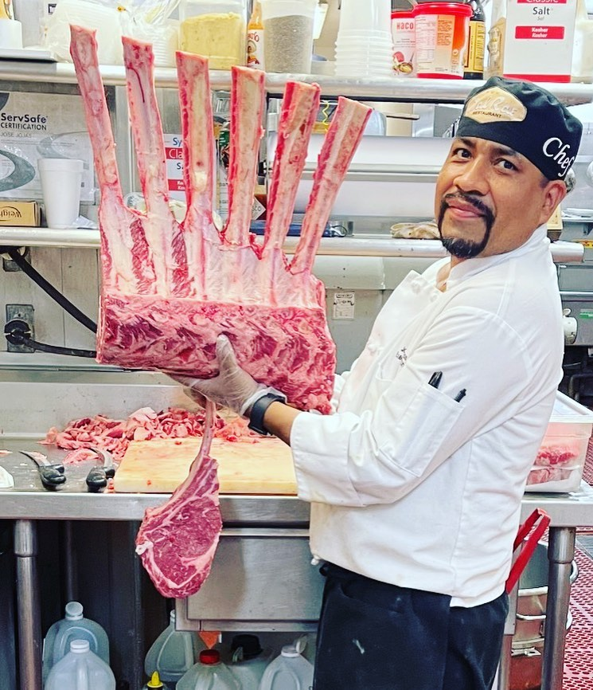
Problem Statement
Can we ensure the Dal Rae’s red meat entrées maintain a contribution margin of 75% in a post-covid world?
We will be evaluating Dal Rae's red meats in particular, since this is the area where we have seen the most significant increase in costs
Problem within the chosen problem
Profitability can be adjusted in many different ways (Revenue side, Cost Side, etc.)
How do we know which way of solving the problem is optimal in terms of customer sentiment?
Dal Rae management wants to first understand how their customer base views them
management can then take action with knowledge of what potential trade offs are most preferable to customers
before we can select a model to help us solve this problem, we must first conduct this research

Slide 8
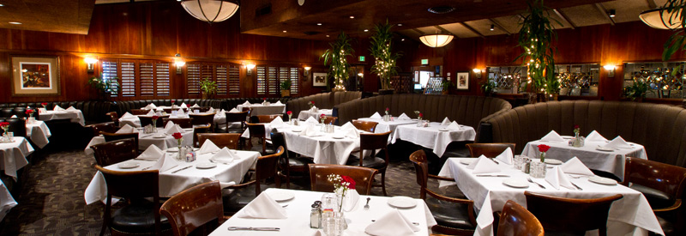
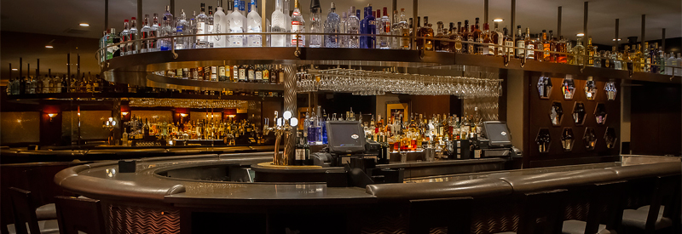
Market Segmentation: Secondary Research
Based on historical industry knowledge, management perceives the Dal Rae as a restaurant that has attracted affluent diners over its 65 year tenure
Can secondary market research validate these inferences about their customer base?
the average US household spends about $198 monthly on food prepared away from home, while the average check paid at the Dal Rae is about $218.25
the average commercially produced meal costs $13, while the average cost per person at the Dal Rae is $64
These figures lend credibility to management's claims that the restaurant services affluent diners
We form the hypothesis that diners will be largely insensitive to price

Slide 9
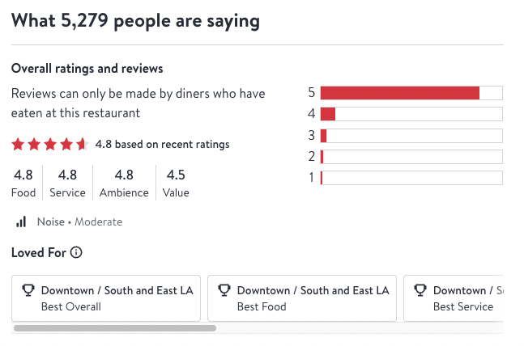
Market Segmentation: Secondary Research
Management operates under the perception that the customer base places an emphasis on exceptional ingredient quality and service
The tags “Best Food,” “Best Value,” and “Best Service,” taken from OpenTable Diners’ Choice Lists for the Los Angeles area, are signs that customers do indeed hold this view
Management believes that the restaurant serves as a great place for business meetings and special occasions
The tag “Good for Special Occasions” from OpenTable Diners’ Choice Lists is a good sign that management's perception is reality

Slide 10

Market Segmentation: Primary Research
We believe the best way to understand customer preference and perception is to go directly to the customers using Google Forms
helps us confirm inferences management has made about their customer base
helps management uncover customer sentiment they didn't previously know existed
allows management to make tradeoffs that align with customer preferences

Slide 11





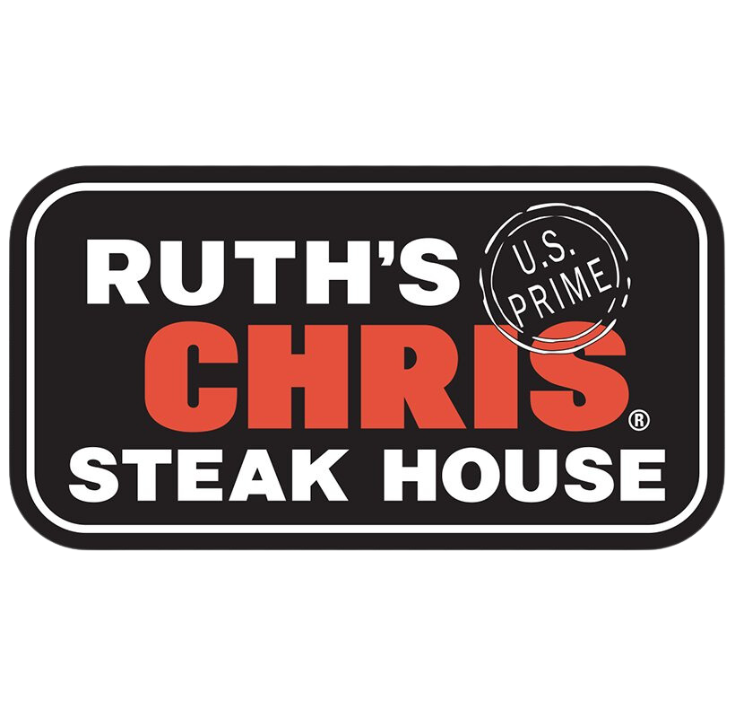



Market Segmentation: Primary Research
Customer Survey Structure
Competitive Analysis: Attributes
Competitive Analysis: Use Cases
Customer Sensitivity to Tradeoffs
Understanding Price Associated Dining Frequency
Demographics
For both of our competitive analysis survey sections, we asked respondents to rate specific qualities across many of the competing restaurants in the Los Angeles area
The restaurants included are Dal Rae, Ruth’s Chris, Fleming’s, Mastro’s, Houston’s, Smitty’s Grill, Arroyo Chop House, Parkway Grill, and Old Brea Chop House
The subsequent two sections are Dal Rae specific

Slide 12
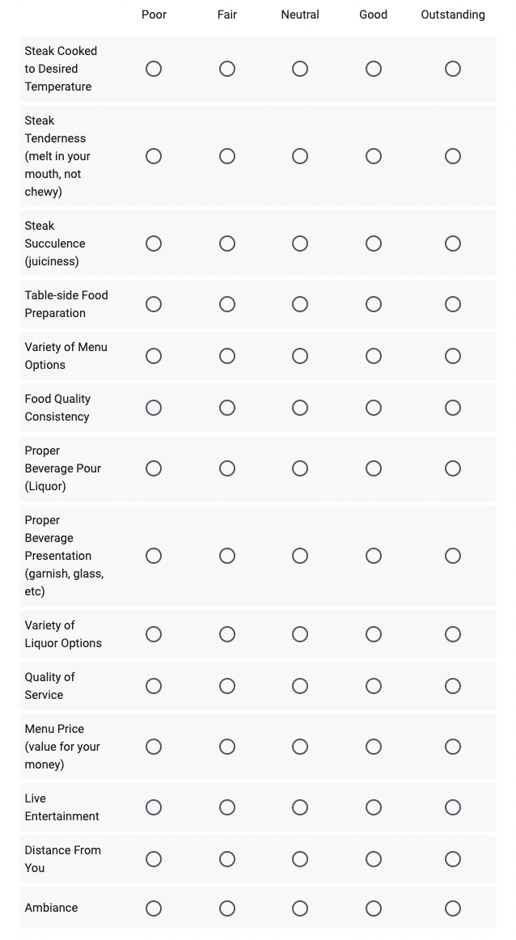
Competitive Analysis: Attributes
We asked respondents to rate each restaurant based on the attributes listed on the right
The attributes listed are based on our perception of what diners look for in high-end steakhouses
The ratings were collected on a spectrum from Poor to Outstanding

Slide 13
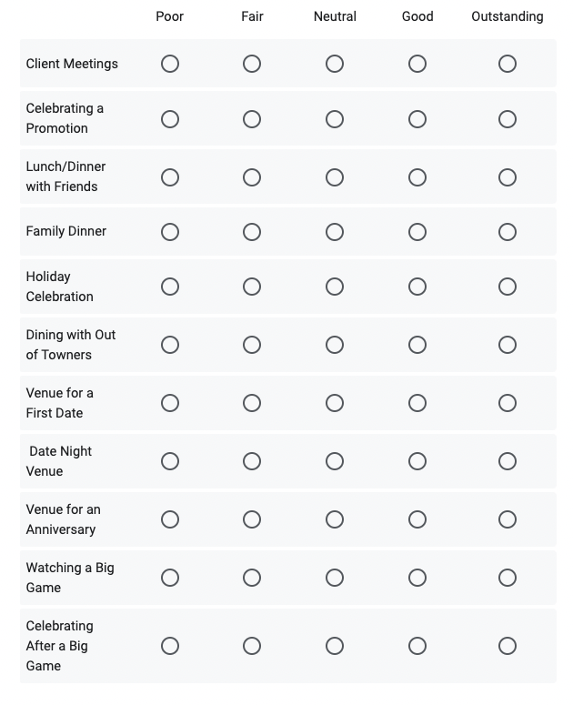
Competitive Analysis: Use Cases
We additionally asked respondents to rate each restaurant based on particular use cases
The use cases listed are also based on our perception of what diners look for in high-end steakhouses
The ratings were collected on a spectrum from Poor to Outstanding

Slide 14
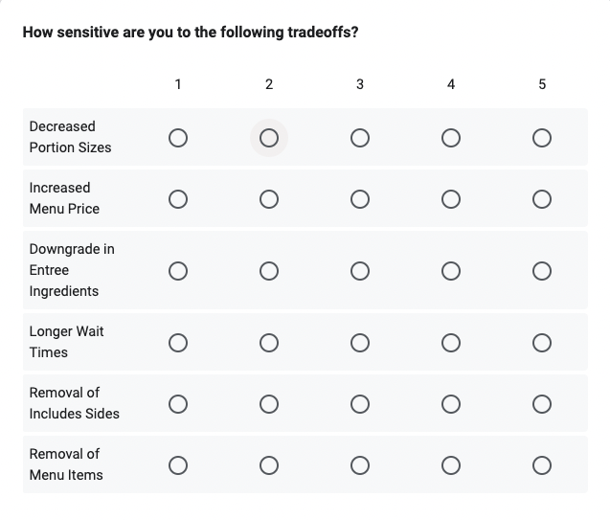
Customer Sensitivity to Tradeoffs
This section was dedicated to determining customer sensitivity to changes in restaurant practices
Ratings were collected on a spectrum of 1 to 5
Rating of 1: Change Doesn’t Matter to Me
Rating of 5: Vehemently Against this Change
Decreased Portion Sizes
receive a 8oz steak instead of a 10oz steak for the same price
Increased Menu Price
pay slightly more for an entrée the same quality and size
Downgrade in Entrée Ingredients
receive lower quality meat for the same price
Longer Wait Times
wait longer for order due to decreased staffing
Removal of Included Sides
your entrée no longer comes with sides included
Removal of Menu Items
removal of items which are high in popularity but low in profitability

Slide 15
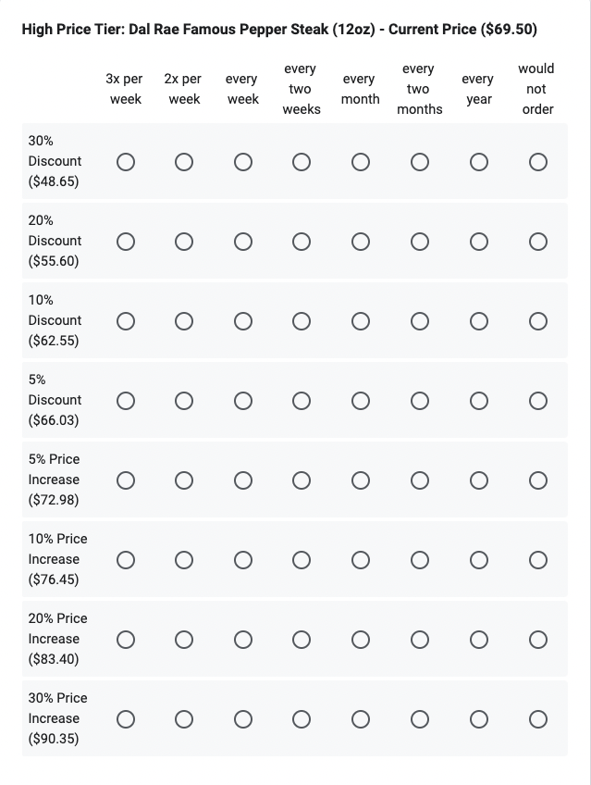
Price Associated Dining Frequency
The goal of this section was to determine how customers dining frequency would be affected by changes in the price of menu items
Customers may react differently to price changes based on the original price of the item, this structure helps us capture this phenomenon
Price Tiers: Low ($20-$30), Medium ($30-50), and High ($50+)
In order to give respondents specific price points to evaluate, we used the most popular entrée from each price tier as a proxy
Low Tier: Poor Man’s Pepper Steak - $22.75
Medium Tier: Medallions of Filet Mignon - $44
High Tier: Dal Rae Famous Pepper Steak - $69.50

Slide 16
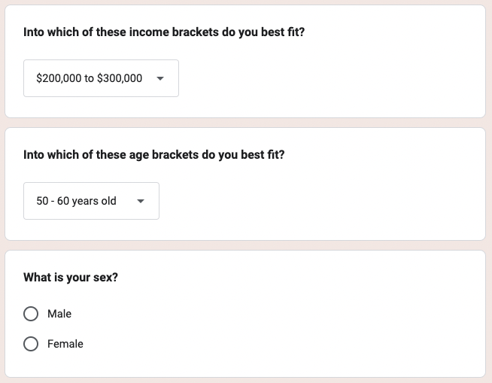
Demographics
In the final section of our survey, asked our respondents to give us basic demographic information
The answer choices for income brackets were:
$0 to $100,000
$100,000 to $200,000
$200,000 to $300,000
$300,000+
For their age, respondents could choose any age range of 10 years between 20 and 100 years old

Slide 17
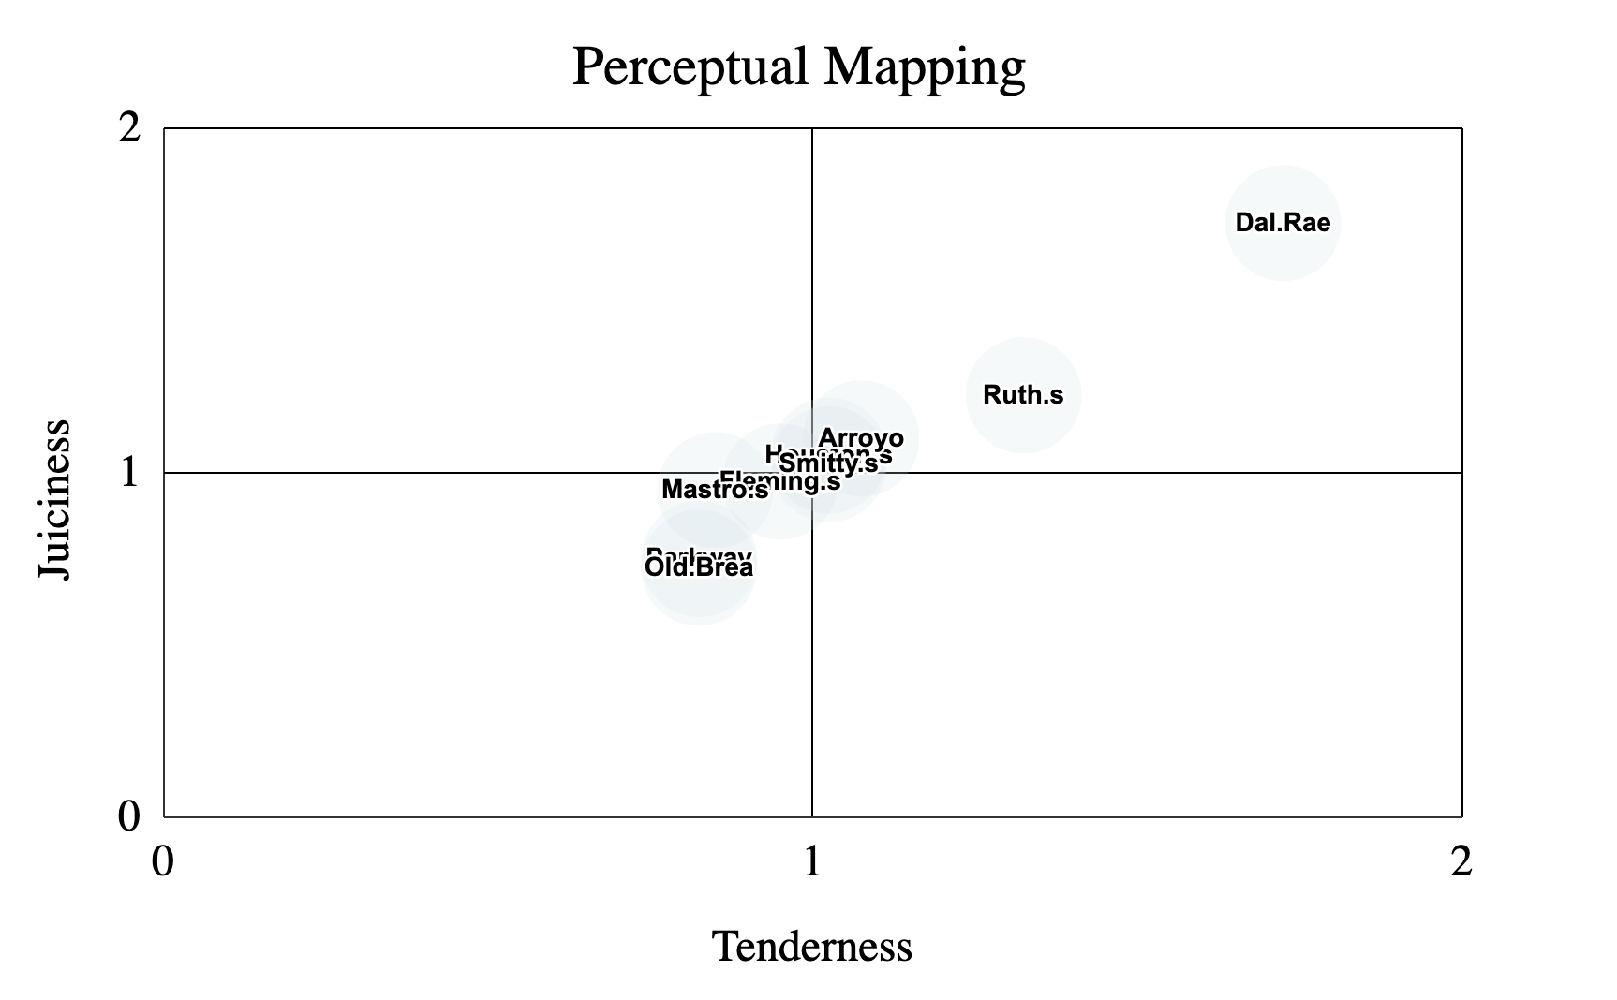
Results: Attribute & Use Case Survey Bias
In order to gain insight on the restaurant attribute and use case data collected, we decided to plot the respondents rankings to Perceptual Maps
Perceptual Maps make it easy to visualize how customers view the Dal Rae versus competitors
Each axis represents a particular attribute
Attributes are scaled from zero to two, with zero being low and two being high
After plotting our perceptual maps, we immediately observed clear bias for the Dal Rae due to the population we issued the survey to, making this portion of the survey unuseable

Slide 18
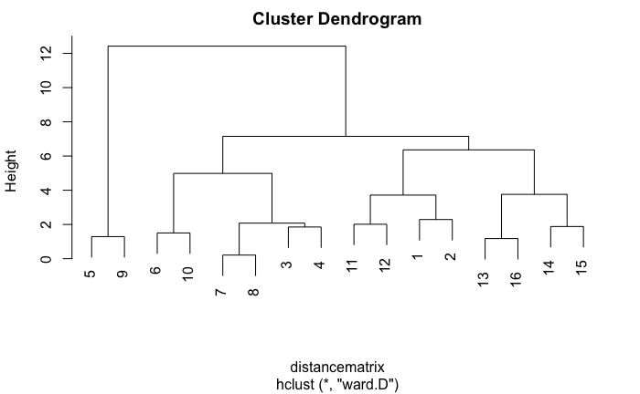
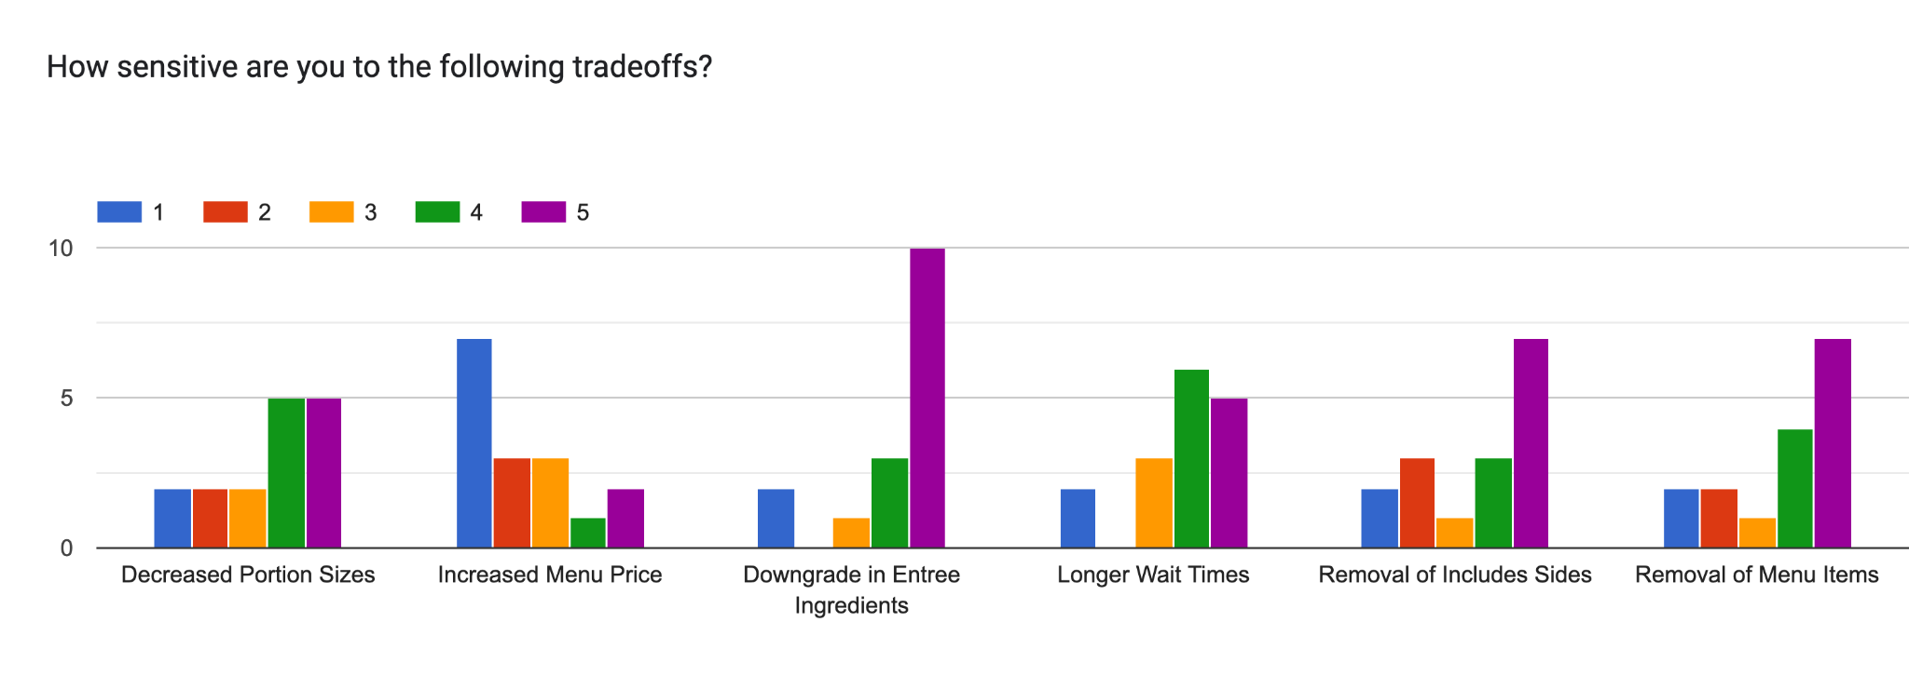
Results: Customer Sensitivity to Tradeoffs
We used Ward’s Agglomerative Clustering to identify how different segments of customers would react to the various potential tradeoffs the Dal Rae could make
We determined that there were 4 main clusters that respondents could be categorized as:
Intolerant of Downgrade In Ingredients, Moderately Tolerant of Everything Else (Size:4)
Moderately Tolerant of Price, Nothing Else (Size:6)
Apathetic Cluster (Size:2)
Intolerant of Removal of Sides, Removal of Menu Items & Downgrade of Ingredients, Moderately Accepting of Everything Else (Size:4)
Overall, the tradeoff customers were least sensitive to was increased menu price

Slide 19
Results: Price Associated Dining Frequency
We used our survey data to evaluate demand elasticity based on respondents reported dining frequency at various price points
What the data revealed was unexpected:
Elasticity was the same across all three entrées from differing price tiers
Elasticity was much higher than we expected, with the percentage of quantity demanded changing increasing more than twice as much as the percentage of price change, contrary to our hypothesis and our customer sensitivity to tradeoffs section of the survey
Despite our skepticism in the overall accuracy of our survey elasticity calculations, the survey helped us model additional data we couldn’t obtain from POS system data
We learned about customers adverse reaction to price increases on the high end of the spectrum
Poor Man’s Pepper Steak
Elasticity: 2.68
Medallions of Filet Mignon
Elasticity: 2.66
Dal Rae Famous Pepper Steak
Elasticity: 2.69

Slide 20
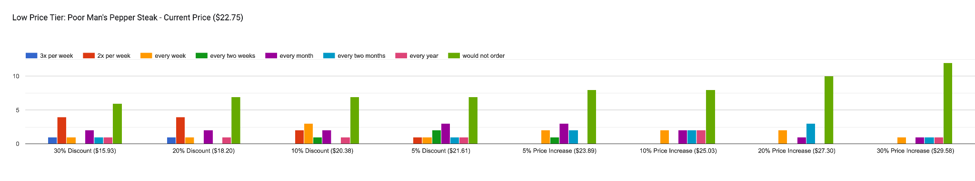
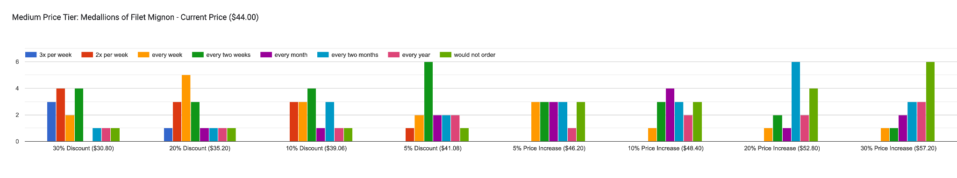
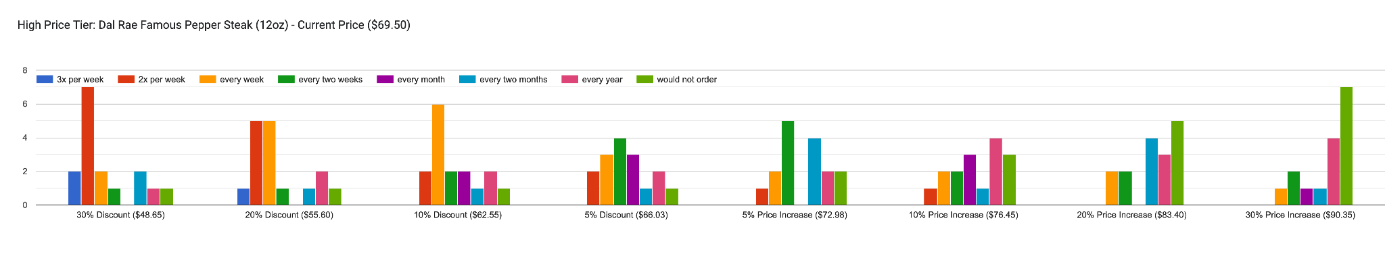

Slide 21
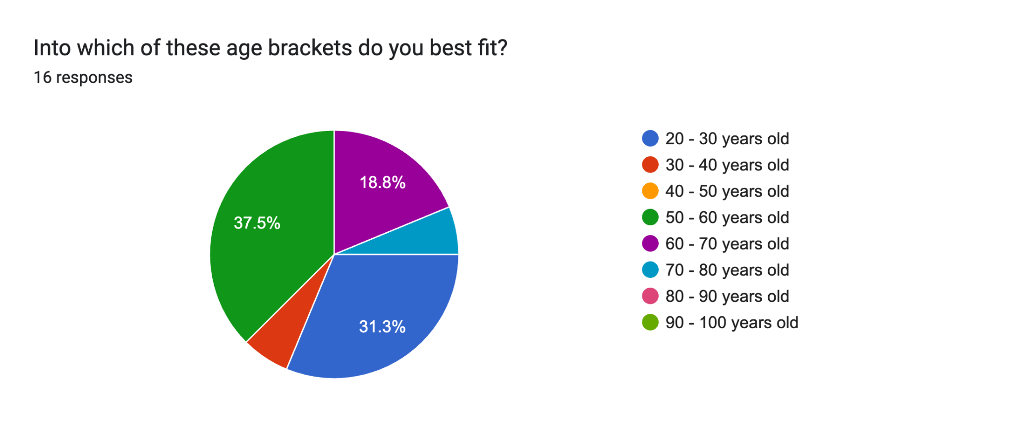
Results: Demographics
62% of our respondents shared the following characteristics:
had an annual income of over $200,000
Affirms our belief that the customer base has high amounts of discretionary income
were over the age of 50 years old
male
These findings support the historical perception of the customer base management holds

Slide 22

Aloha Point of Sale Data (POS)
Seeking to confirm the accuracy of our survey results, we decided to compare survey respondents stated dining frequency with actual POS order frequency
We accessed secondary sales data from the Dal Rae Aloha Point of Sale System dating back to 2018
The elasticity of each entrée studied varied dramatically, unlike results from our survey
Low Price Tier: 1.07
Medium Price Tier: 0.36
High Price Tier: 0.22

Slide 23
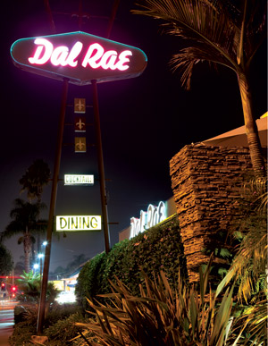
Customer Sentiment-Based Solution
We synthesized all of the information that we learned from our primary and secondary research, considering the bias that came from each source
We determined that the best course of action to ensure the Dal Rae restaurants continued profitability would be a combination of menu price adjustment, portion size reduction, and removal of included entrée sides for these reasons:
Customers indicated they would be most tolerant to these approaches overall in our customer trade off sensitivity survey section
POS data reliably predicts that medium and high priced entrées are highly inelastic, while survey data gives us an estimation of upper pricing bound
Most competitors require customers to pay extra for sides on top of the price of the entrée, this gives the Dal Rae wiggle room

Slide 24
Model Selection: Demand-Based & Markup Pricing
We have selected two models to help ensure the Dal Rae’s contributions margins can be brought back to 75%
We will utilize Demand-Based Pricing to assist the Dal Rae in achieving their desired Markup Price
Demand-Based Pricing expands on the concept of elasticity that we have already used to evaluate how the percentage in quantity demanded changes in response to a percentage change in price
Limitation: Because Dal Rae has always priced their entrées using a combination of Markup and Going Rate Pricing, menu prices presented in POS data have always reflected the fair value of the market
Increasing prices beyond a perceived fair value threshold could lead to a steep drop in sales despite POS model extrapolations
Triangulation Remedy:
For the price levels that the Dal Rae has served entrées in the past, we have reliable POS data to forecast sales
For price levels that are higher than the Dal Rae has ever charged for their entrées, we can triangulate our POS data’s expected rate of demand decline with our more speculative survey data to estimate impact on sales
Because all menu prices are already the highest they have ever been, we will be using a triangulation of both models to make decisions on all upwards price adjustments
Price
Quantity

Slide 25
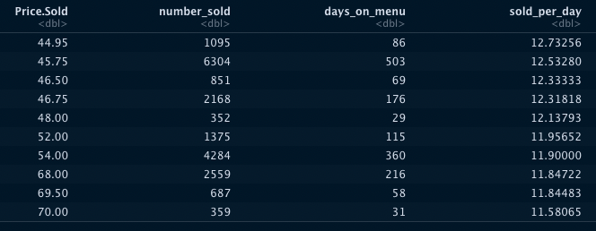
Aloha Point of Sale Data (POS)
Our demand curves capture three different variables:
Price Level
Time on the Menu (At Price Level)
Quantity Sold
Without accounting for the amount of time an item was on the menu at each price point, demand curve analysis cannot discern whether the demand for an entrée increased or decreased
To achieve this, we have combined the variables Time on the Menu (At Price) and Quantity Sold to create a metric called Sold Per Day
Dal Rae Famous Pepper Filet Mignon

Slide 26
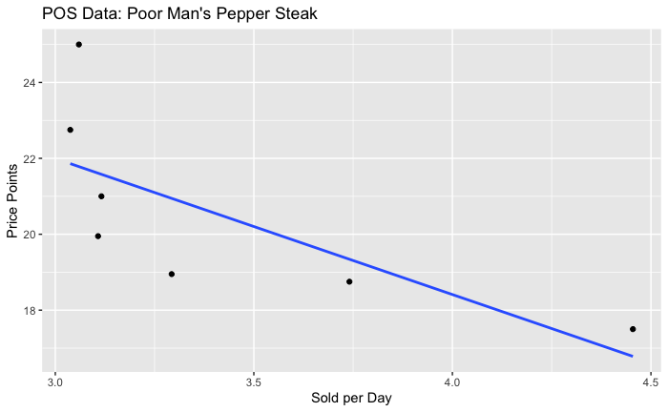
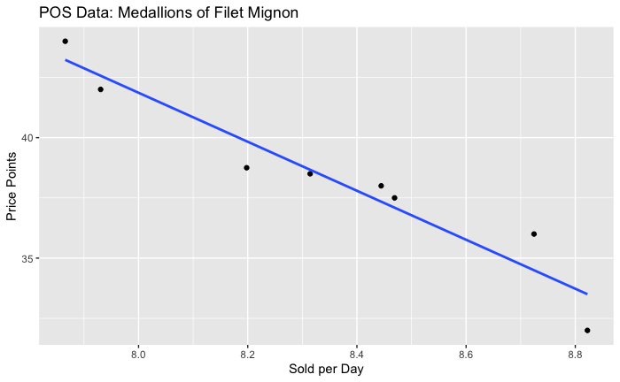
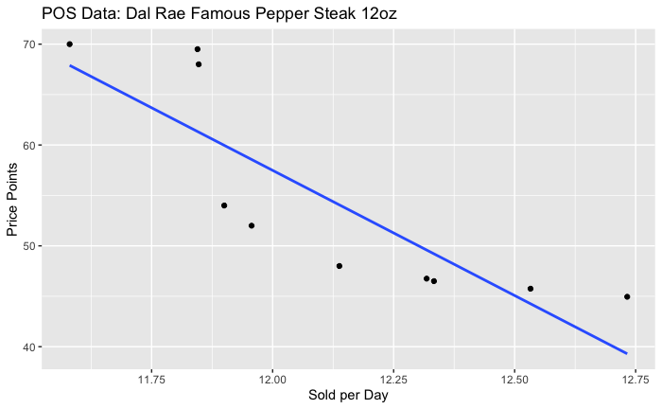
Model Visualization: POS Quantity Sold Per Day At Price Level
Low Price Tier
Medium Price Tier
High Price Tier
Elasticity: 1.07
Elasticity: 0.36
Elasticity: 0.22

Slide 27
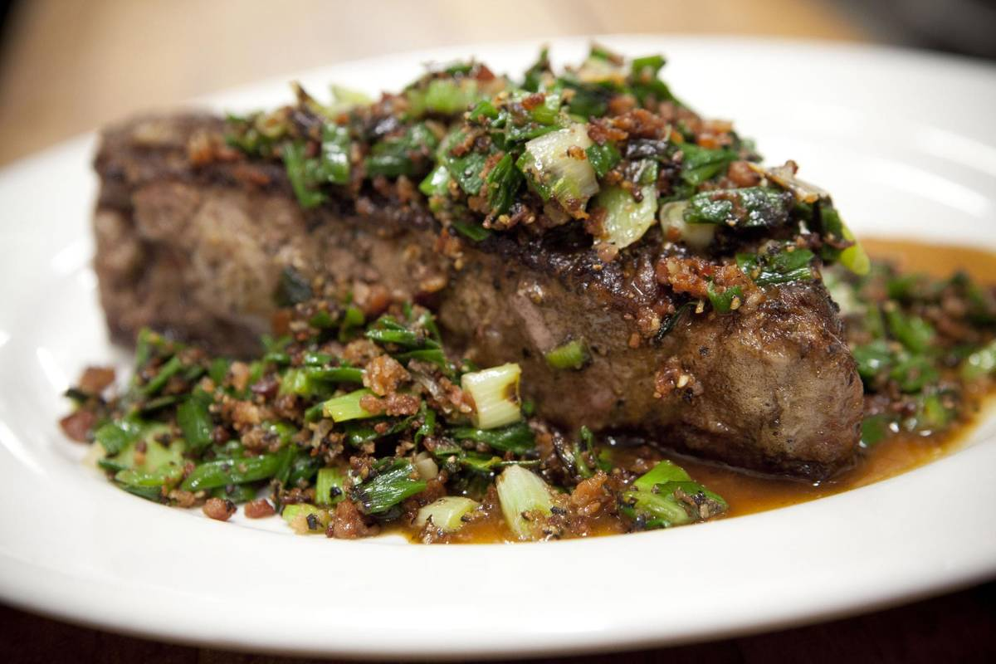
Results Interpretation & Conclusions
Using our Markup Model, we find that in order for the Dal Rae to achieve their desired minimum contribution margin of 75% using price increases alone, they would have to make the following price increases:
Medallions of Filet Mignon: No change ($44.00 at current costs is sufficient to achieve a 76.7% contribution threshold)
Dal Rae Famous Pepper Filet Mignon: $69.50 -> $82.00 (18%)
Because the Dal Rae has never charged a price this high for its Famous Pepper Filet Mignon, we refer to our survey demand curve data collected on elasticity:
We find that this repricing of the Dal Rae Famous Pepper Steak would reduce the dining frequency of the average customer from approximately once every 2 weeks to approximately once every 4 weeks

Slide 28
Results Interpretation & Conclusions
Next, we evaluate how our contribution margin would be affected by changes in offered portion sizes using Markup Pricing
We find that offering a 10oz Dal Rae Famous Pepper Filet Mignon at the current $69.50 price point, instead of offering 12oz, would be enough to bring its contribution margin up from 70.4% to 75.4%
A combination of the pricing and portion size adjustments could result in the following increases in our contribution margins:
Offering a 11oz Dal Rae Famous Pepper Steak for $76 could serve as a middle ground between the two prior approaches, achieving a contribution margin of 75.3%
The final approach customers were moderately tolerant off was the removal of included sides
The Dal Rae offers customers complimentary garlic bread and additional sides, including Fresh Vegetables, Choice of Baked Potato, Mashed Potatoes, Rice Pilaf, French Fries, Brown Rice or Sliced Tomatoes
The removal of these free items would boost the contribution margins on the entrées by decreasing the costs associated with them

Slide 29
Situation Comparison
Before deciding on our final course of action, we should also take into consideration the actions of competitors
Menu prices of competitors reveal that most have utilized the same menu price adjustment strategy to cope with higher inflation just as the Dal Rae has
RESTAURANTS | STEAKS | AMOUNT | PRICE | PRICE/OZ
Dal Rae | Filet Mignon | 12 | $69.50 | $5.79
Ruth's Chris Steakhouse | Filet | 11 | $52.00 | $4.73
Fleming's Prime Steakhouse | Main Filet Mignon | 11 | $60.00 | $5.45
Mastro's Restaurants | Filet | 12 | $64.00 | $5.33
Old Brea | Filet Mignon | 10 | $65.00 | $6.50
Houston's | USDA Prime Center-Cut Filet | NA | $62.00 | NA
Arroyo Chop House | Filet Mignon | NA | $69.00 | NA
Parkway Grill | USDA Prime Filet Mignon | NA | $69.00 | NA
Smitty's Grill CA | Filet Mignon | NA | $56.00 | NA

Slide 30
Recommendations
We do not recommend the Dal Rae use menu price adjustment as an independent tool
Despite customers high tolerance of price increases in the face of alternatives, this aggressive change in demand speculated is not favorable to the business, even at the elevated prices being charged
We do not recommend that the Dal Rae choose the middle ground option of increasing the price of the while decreasing the portion offered to 11oz
We do not recommend the Dal Rae remove its complimentary sides
Customers receiving complimentary sides creates a “value for the money” competitive advantage that shouldn't be foregone in an effort in maintain contribution margin
While respondents indicated they were mildly comfortable with the removal of free sides, the removal of included sides could have much more detrimental effects to customer perception than anticipated in practice
We recommend that the Dal Rae choose to reduce its portion sizing while keeping all else constant
We suggest offering a 10oz Dal Rae Famous Pepper Filet Mignon at the current $69.50 price point, instead of offering 12oz
This would bring its contribution margin up from 70.4% to 75.4%, above our 75% target markup threshold
This would also keep the Dal Rae’s listed menu price competitive with other steakhouses, such as Old Brea Steakhouse, which charges $65.00 for a 10oz filet mignon

